Slide 1


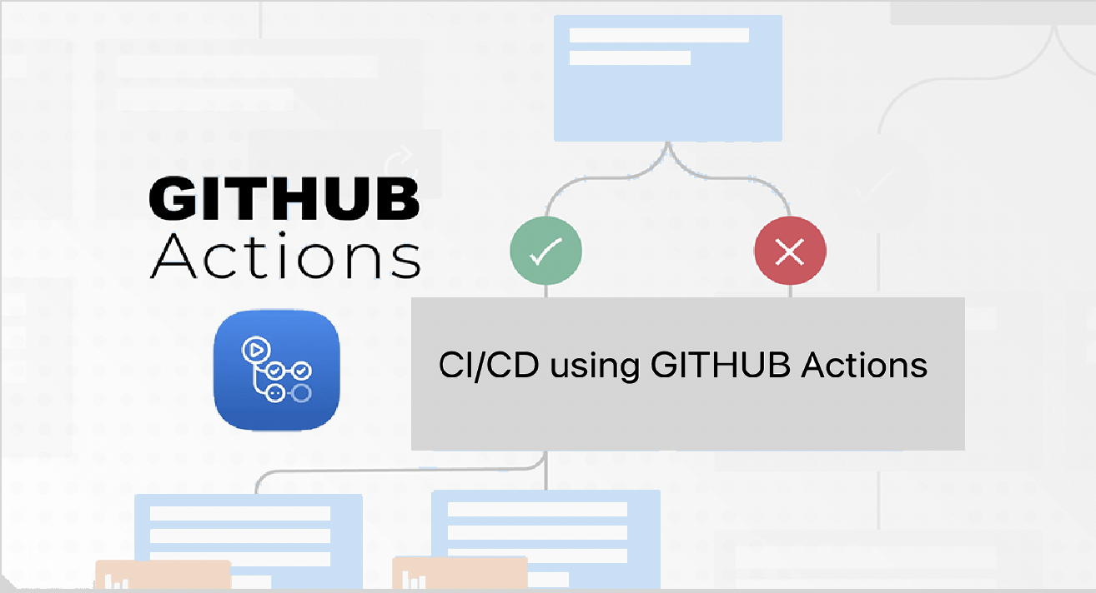

Slide 2
GITHUB Actions?
It helps to automate the Software development workflows.
There might be multiple work flows like CI/CD is one of them.
One workflow will be set of jobs, and jobs contain steps or action to be performed.

Slide 3
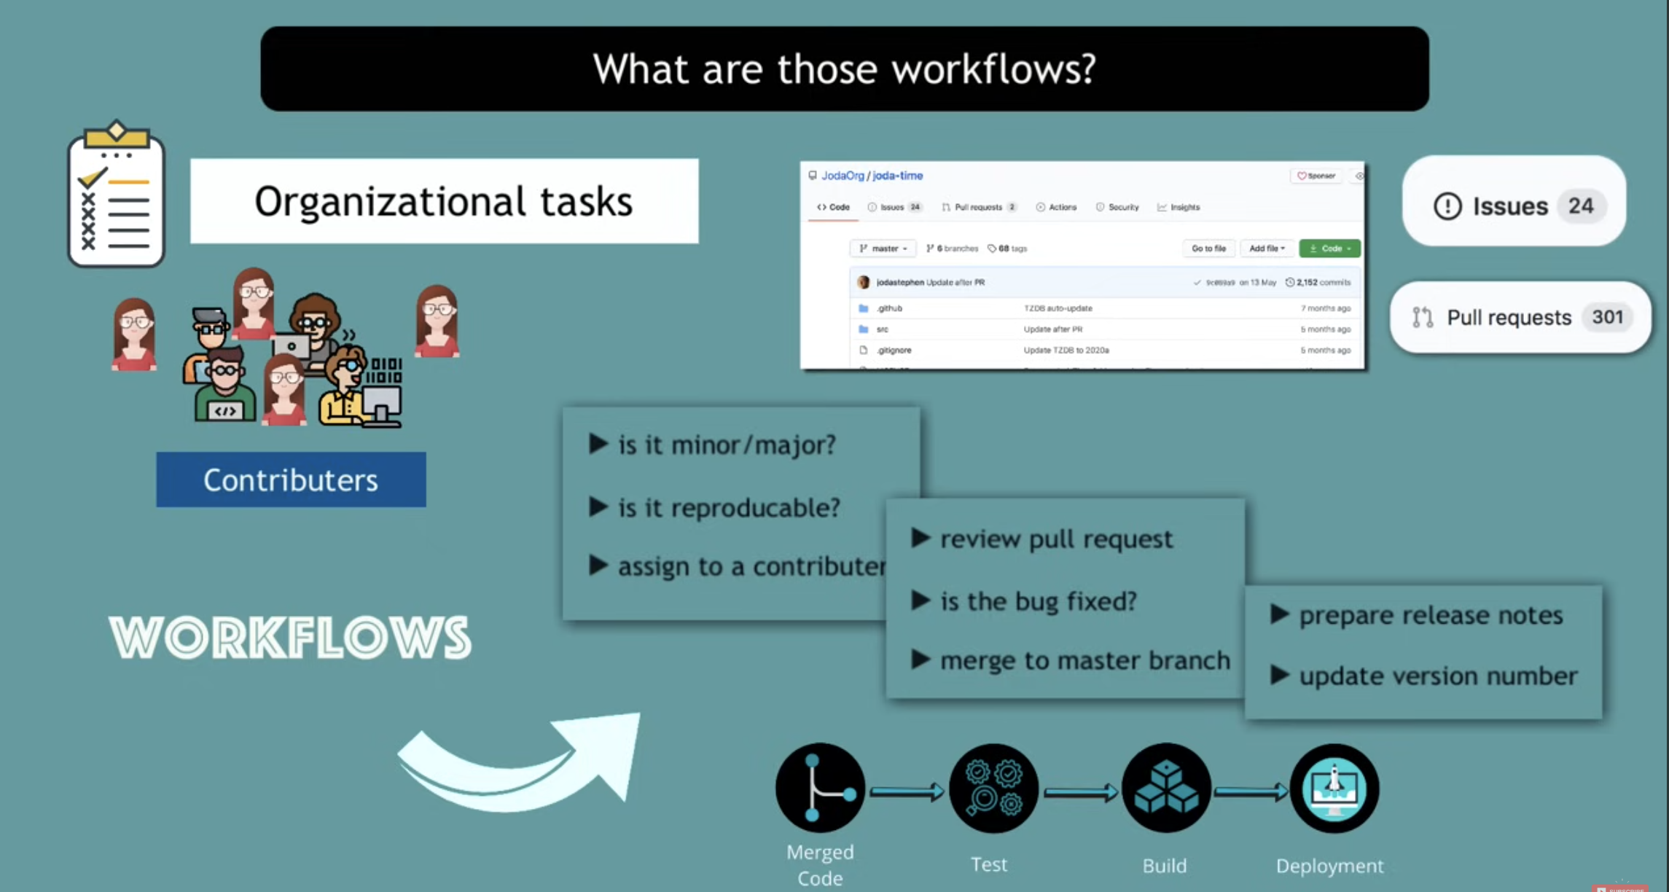
Example of one common workflow : Public repo —> Contributor added some code in last release —> found minor big —> Try to reproduce and assign it to one of the contributor —> review Raised MR against fix —> if not reproducible merge with master —> Prepare the release notes and update the new release version.
To Track all these activity manually it would be tedious task and also tough to maintain so we can maintain this using GitHub Actions.
If something happens in the repo that we can consider as event and create automatic actions against those event that is nothing but known as GitHub Actions.

Slide 4
Note
GITHUB Action act against GIT Events, Events might be anything like Merge request Create MR, Raised Issue or any short of activity
Now what possible actions we might have against above events? 1. we can sort the issues based on priority or date 2. We can put labels on the tickets 3. We can assign some of the unassigned tickets to the dev. 4. We can try to reproduce the issue once it logged or after fixes
All these actions instead of performing manually we can do automatically with the help if GitHub Actions[ ss attached in next slide]

Slide 5
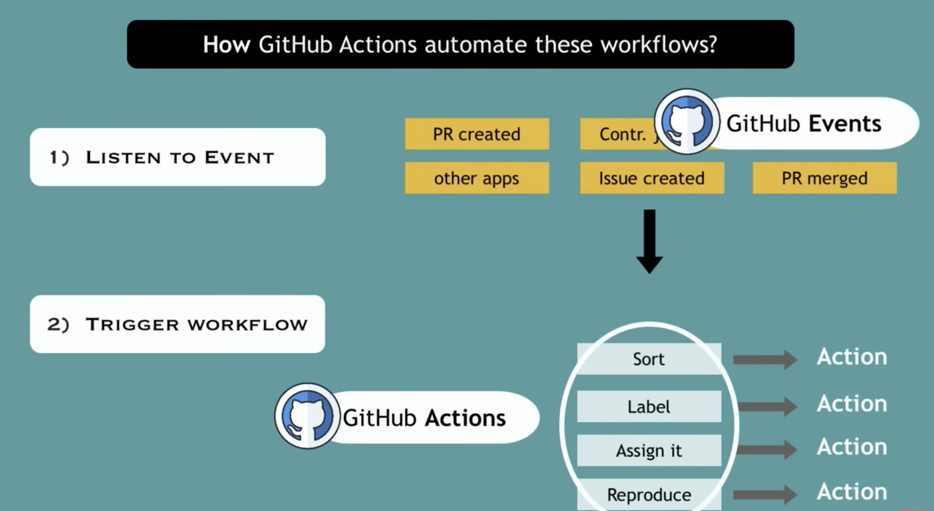

Slide 6
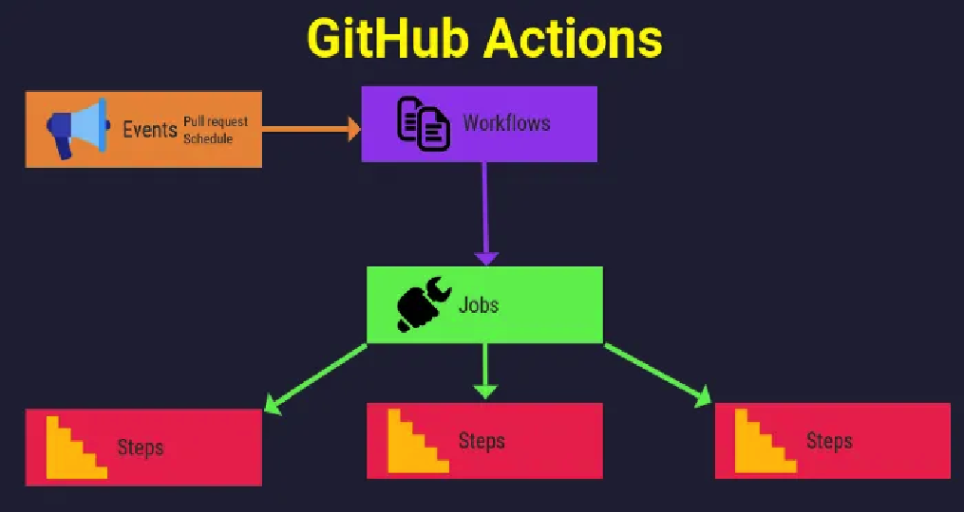
I hope now you guys got some understanding of GIT HUB actions so let's explore the syntax and process for one of the GIT HUB Actions named --> CI/CD

Slide 7
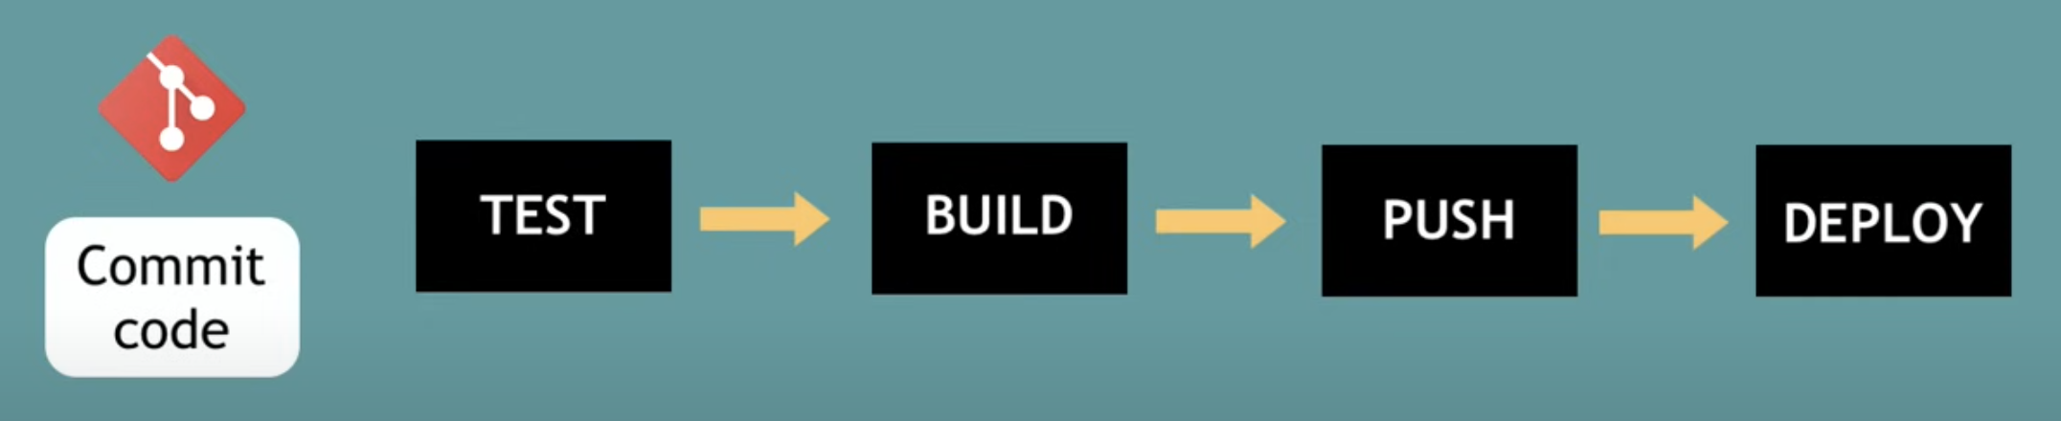
CI/CD: It stands for Continuous Integration and Continuous Deployment.
The most common stages of CI/CD are mentioned in the diagram.
as soon as any commit happens in the code base unit test case execution gets started. post that will create a build and push that to repo, known as continuous delivery. Finally we pick that build and deploy to the server that is known as Continuous Deployment.

Slide 8
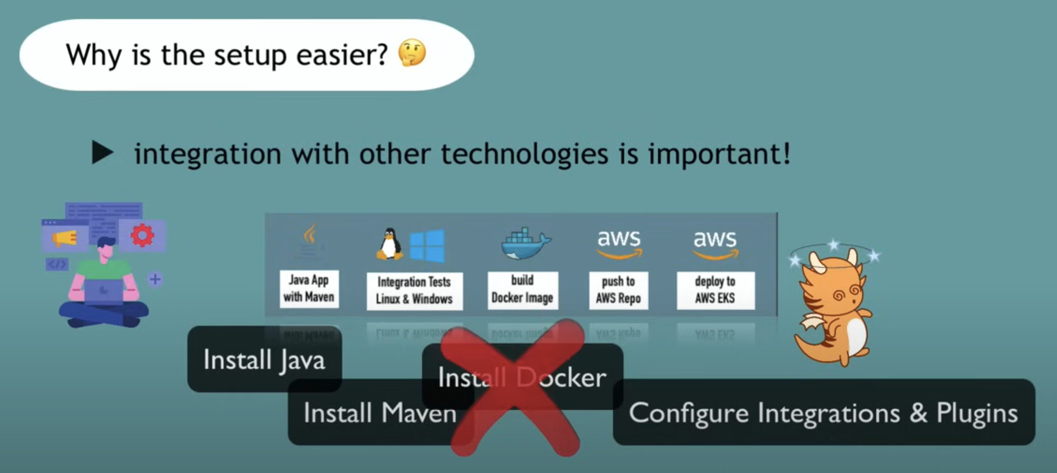
Note: There are multiple tools we need to integrate for each phase of CI/CD to complete work flow and instead of installing all those manually GITHUB actions provide facility to manage all these automatically that is the biggest advantage of the git hub actions.

Slide 9
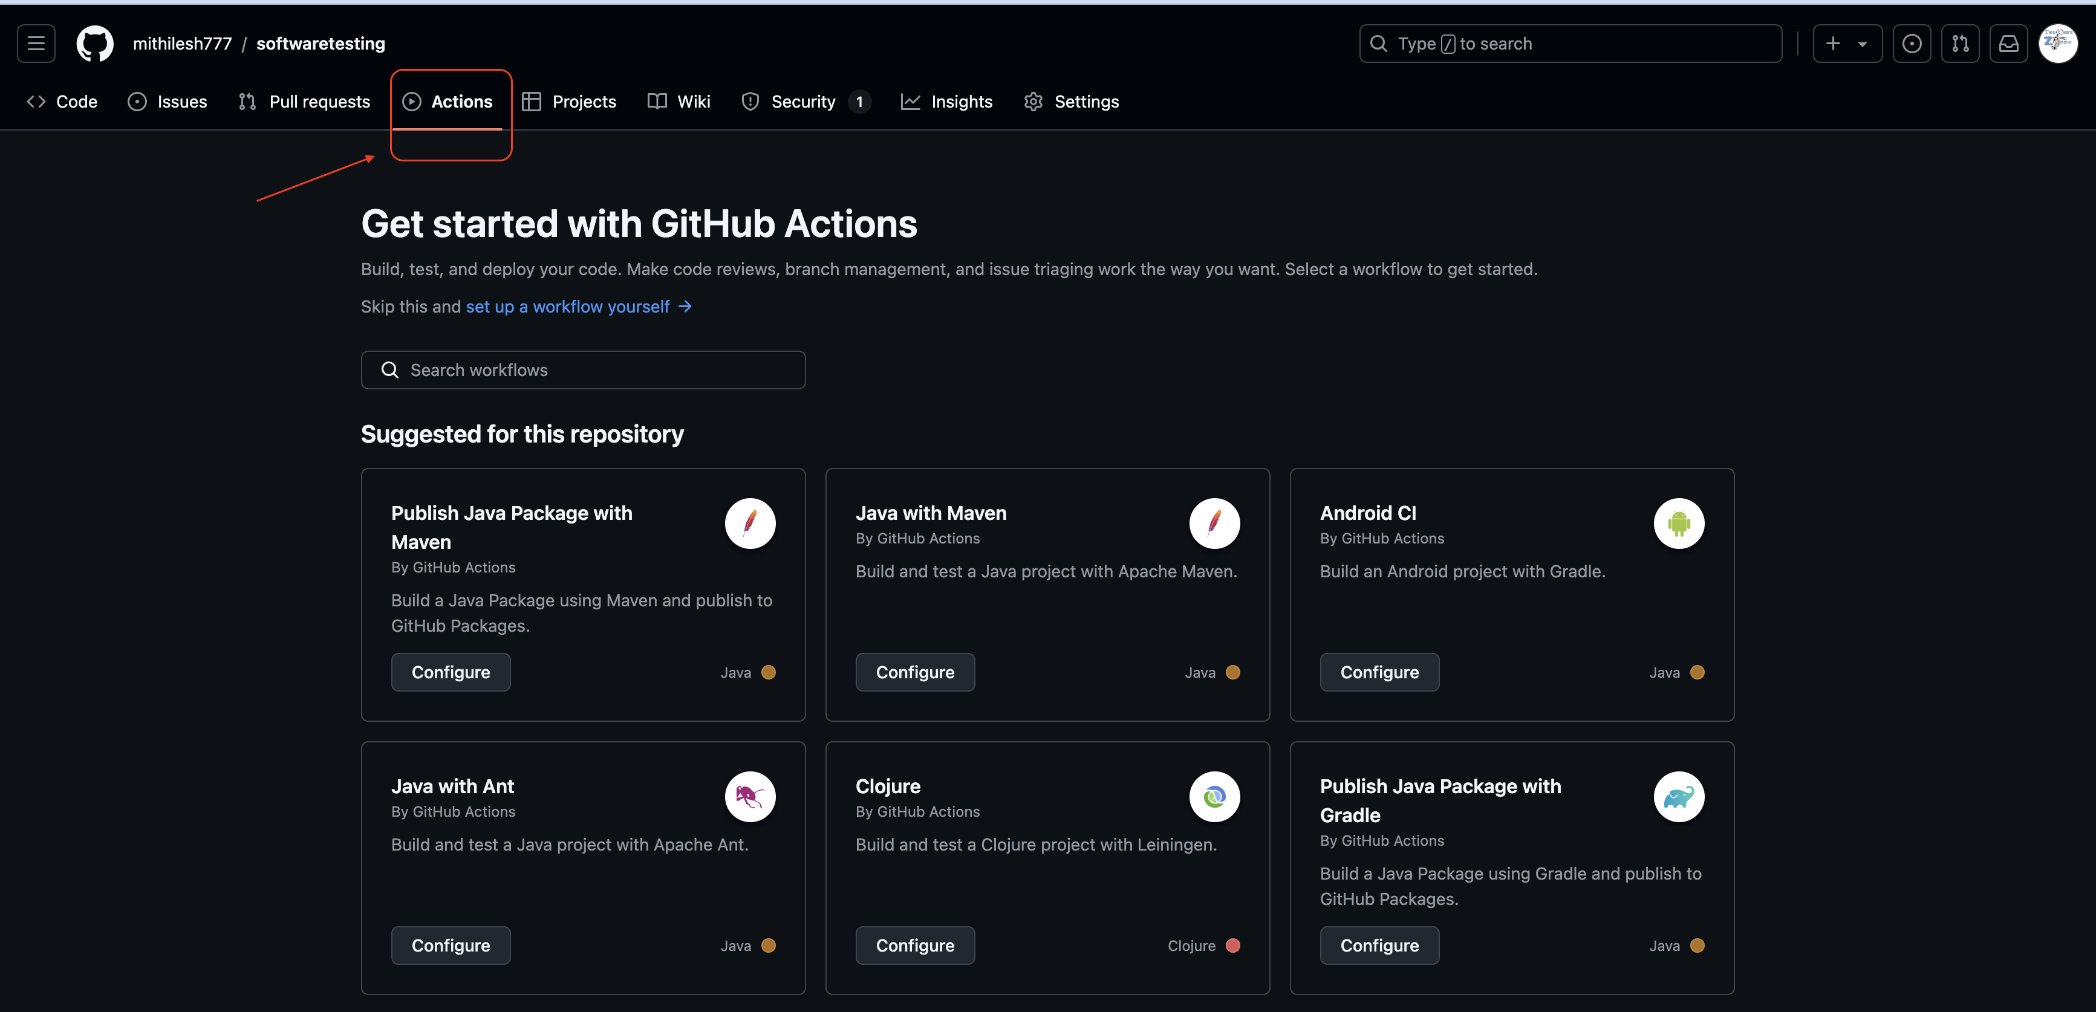
How to choose the git hub actions based on the project requirement?
1. you have to clone your company project 2. Access the git hub repo and go to the actions option shown in ss

Slide 10
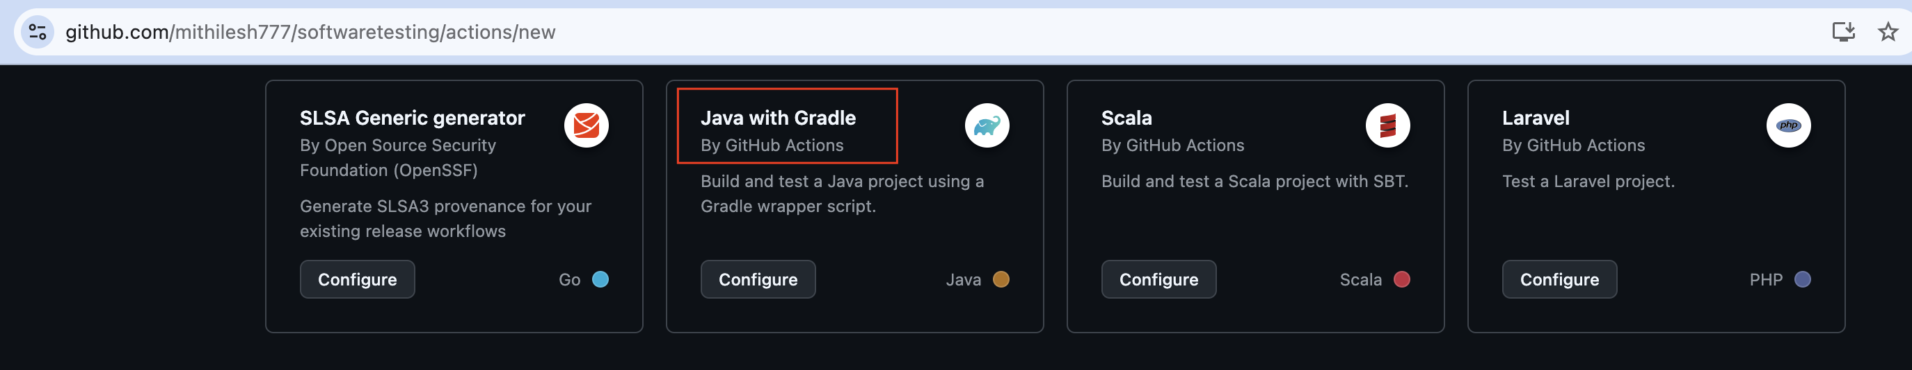
You will get multiple suggested actions which you can configure with your project. Since I am using java gradle project I will use java with gradle GitHub Action

Slide 11
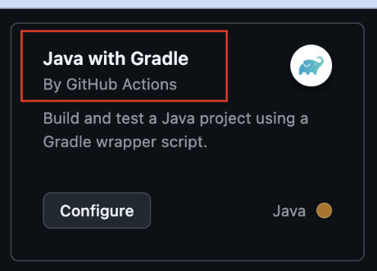
Once will click on configure we will get this kind of template
name: Java CI with Gradle
on:
push:
branches: [ "testerszone/sep2024" ]
pull_request:
branches: [ "testerszone/sep2024" ]
jobs:
build:
runs-on: ubuntu-latest
permissions:
contents: read
steps:
- uses: actions/checkout@v4
- name: Set up JDK 17
uses: actions/setup-java@v4
with:
java-version: '17'
distribution: 'temurin'

Slide 12
Syntax Explanation:
name: Java CI with Gradle —> This is Optional field defines name of the workflow.
on: This is required field where we mention the events which triggers the workflow. e.g. if we want to define action for the push request against master branch then we need to create event for push request like this push: branches: [ master ]
Note: to explore more about the type of events you can visit this link: https://docs.github.com/en/actions/writing-workflows/choosing-when-your-workflow-runs/events-that-trigger-workflows#about-events-that-trigger-workflows
jobs: it groups set of actions. We can have multiple job under jobs tag and each job will be having its name. e.g. if there is build job then we can define like this jobs: build:
Steps: It can run commands, set up tasks or run an action
Uses: it selects predefine code for an action hosted under path actions/ to check the pre-defined action you can visit this link: https://github.com/actions

Slide 13
Syntax Explanation:
runs-on: we can define OS where work flow will execute, it might be window Mac or ubuntu. If we want to execute on more than one OS that also can be managed easily with below snippet of code
runs-on: ${{matrix.os}}
strategy: matrix: os: [ubuntu-latest, windows-latest, macOS-latest]

Slide 14
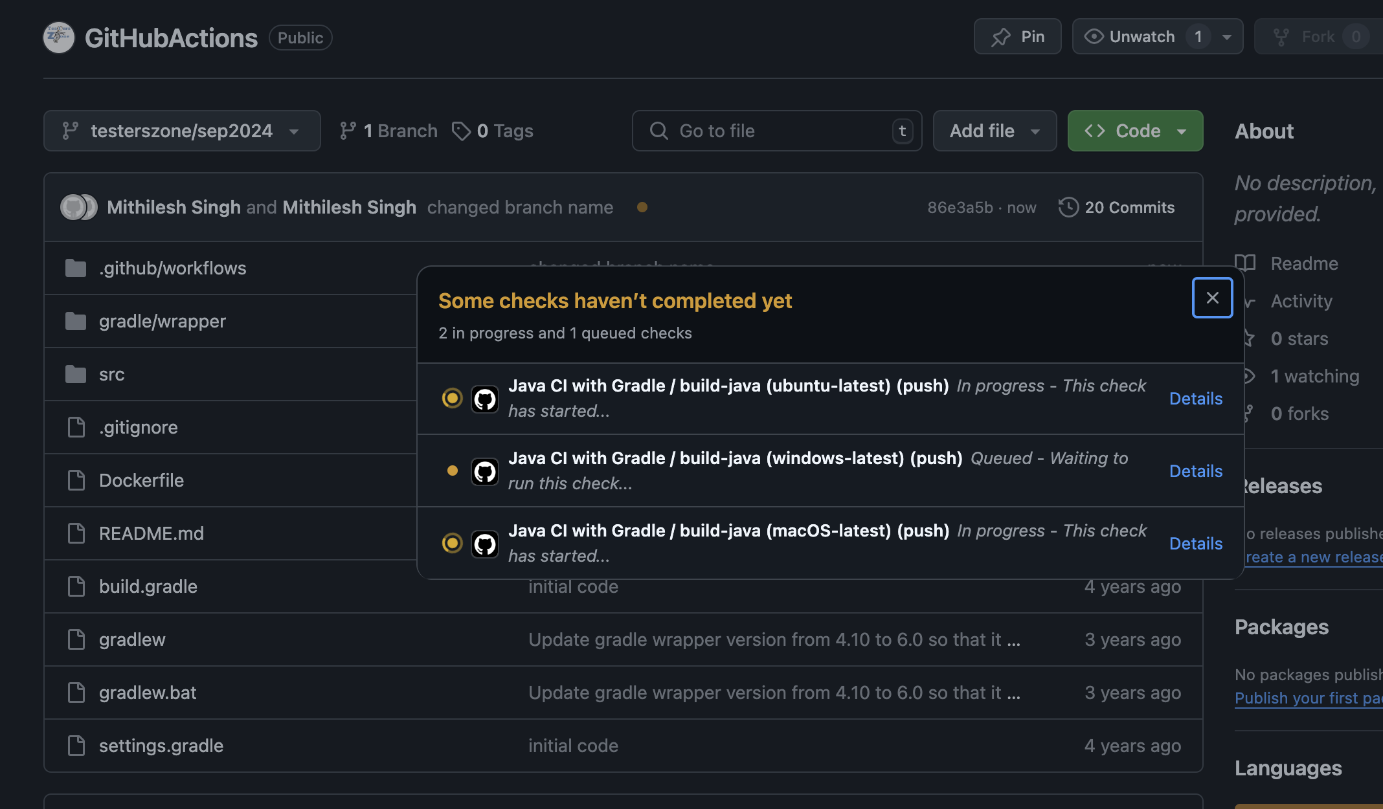
How does execution look like? Once we push the commit to the specified branch [I used master] then action will trigger and can observe like mentioned in the ss.

Slide 15
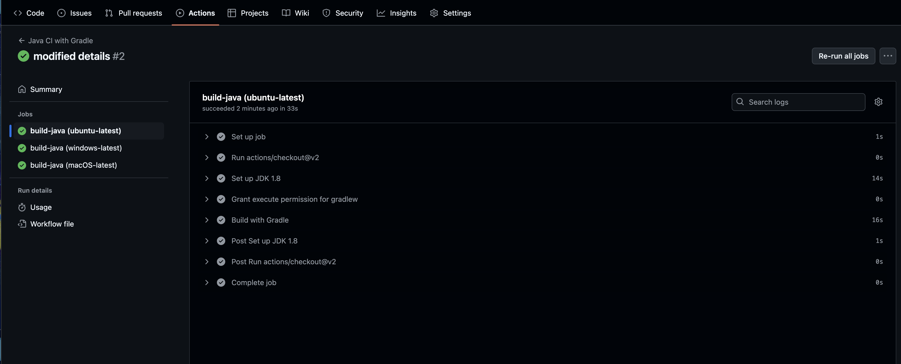
After Execution?
This page will appear once you will click on the details link shown in the previous ss. It will describe the status of steps mentioned In the jobs.

Slide 16
Note: If we have dependency on of running job on another job then it should be in sequence but for that we have to mention in the code like below:
jobs:
build1:
runs-on: ubuntu-latest
steps:
- uses: actions/checkout@v4
- name: Set up JDK 17
uses: actions/setup-java@v4
with:
java-version: '17'
distribution: 'temurin'
build2:
needs: build1
It says build 2 will execute after build 1.

Slide 17
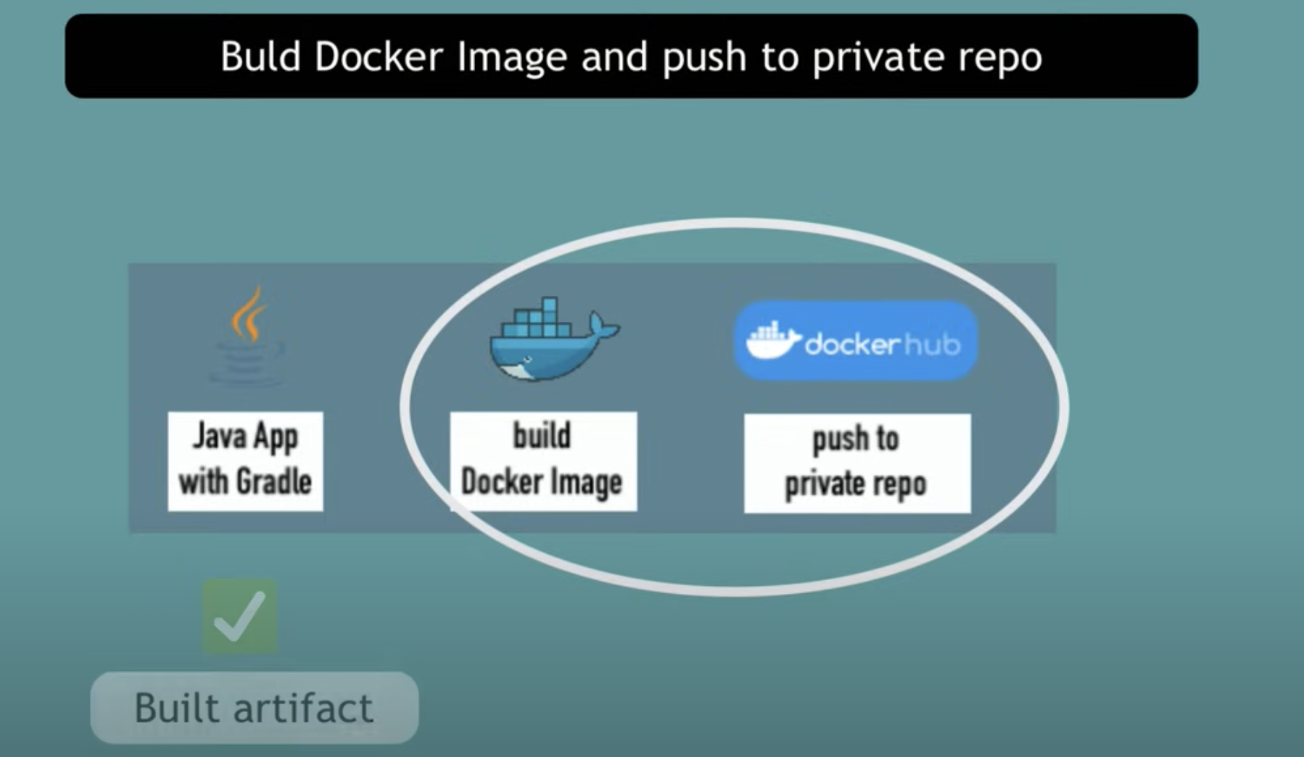
Now we are able to build artifact file now we can create docker image and push it to our private repo. Let’s see how we can do this

Slide 18
Pre-requisite: We can explore the docker build and push action from here : https://github.com/mr-smithers-excellent/docker-build-push
Sample snippet of code copied from above link:
uses: mr-smithers-excellent/docker-build-push@v6
with:
image: docker-hub-repo/image-name
registry: docker.io
username: ${{ secrets.DOCKER_USERNAME }}
password: ${{ secrets.DOCKER_PASSWORD }}
Note: we are using docker hub as docker registry, we have multiple registry like mentioned below and we can get specific snippet of code based on selected registry from above mentioned link:
Docker Hub
Google Container Registry (GCR)
AWS Elastic Container Registry (ECR)
GitHub Docker Registry

Slide 19
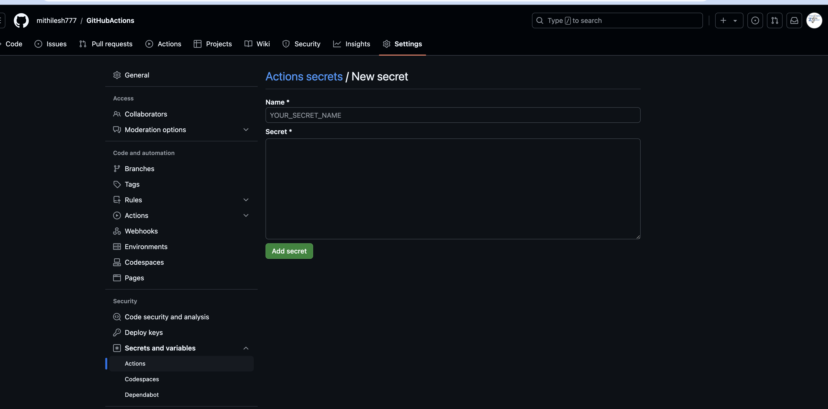
How to create secret in the GITHUB ? Note: username: ${{ secrets.DOCKER_USERNAME }}
password: ${{ secrets.DOCKER_PASSWORD }}
Secrets we can set in git hub for our credential it’s like storing values in variable and call that variable where ever we want you can keep your user name and password directly here that also will work.

Slide 20
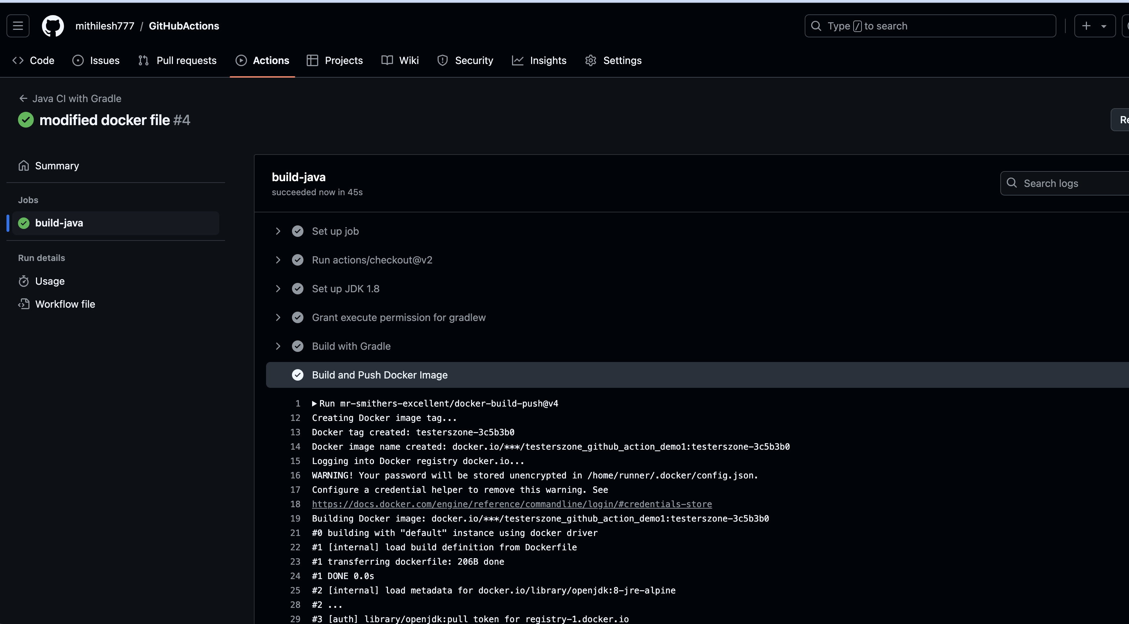
Docker Image creation
Now you can push the commit and check the actions you will get the summary like this

Slide 21
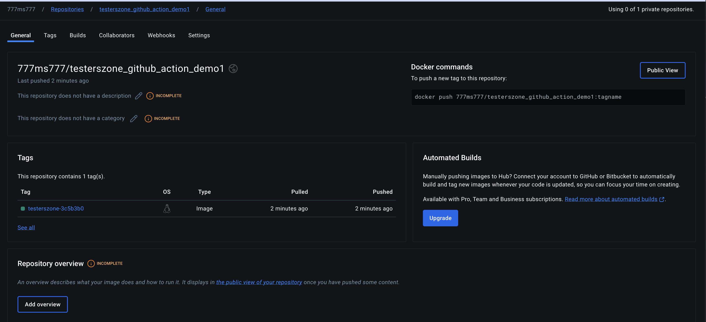
Check the image in your docker hub repo:
You can validate the image name with GIT HUB action logs also as mentioned in the next ss.

Slide 22
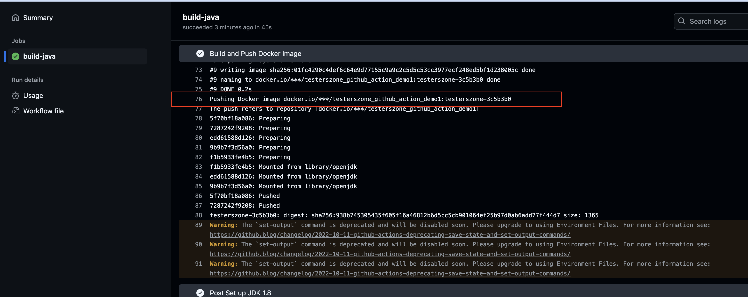

Slide 23
That's it?
Yes, it's simple right? we are able to complete the basic CI/CD set up for few of the git hub events Using GITHUB action.

Slide 24


